Slide 1
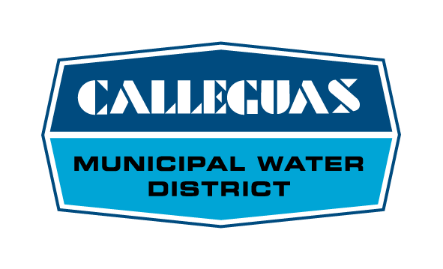
Calleguas Regional Salinity Management Project
Susan Mulligan, General Manager
Calleguas Municipal Water District

Slide 2
Calleguas Service Area

Slide 3
Salt Build-Up
Naturally occurring salts

Slide 4
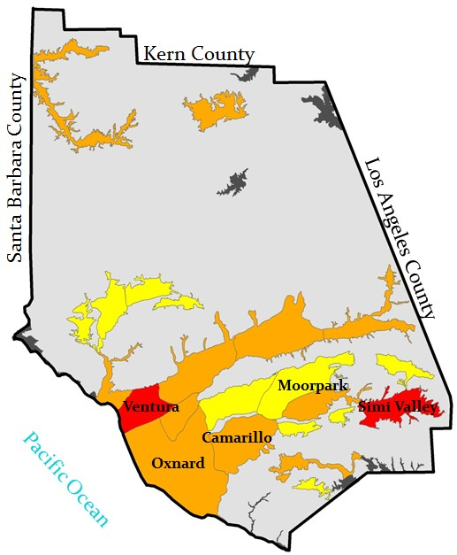
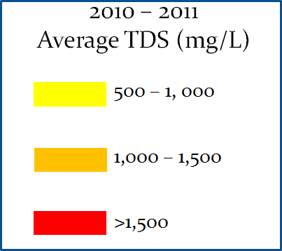
Ventura County
Groundwater Salinity
Total Dissolved Solids (TDS)

Slide 5
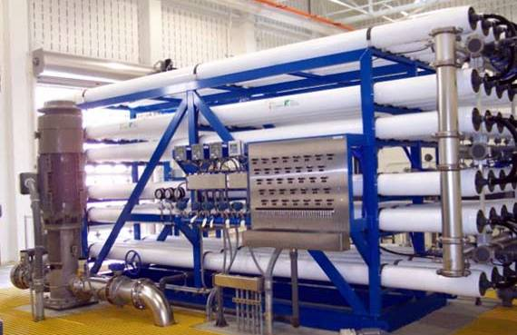
Groundwater Desalter

Slide 6
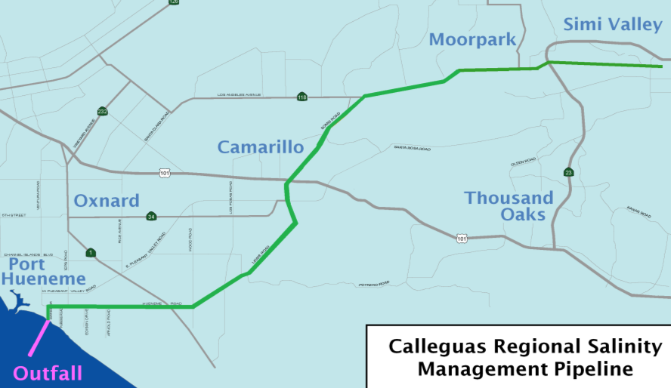
By providing a means of transporting salty water to the ocean, the Salinity Management Pipeline
Increases water reliability
Reduces salinity in the watershed
Lowers greenhouse gas emissions
Facilitates stormwater capture

Slide 7
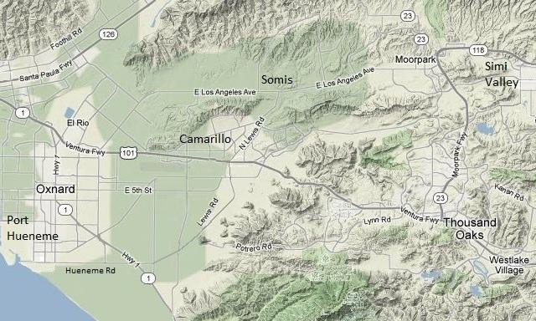
Project Cost: $207M
State Grant Funding:
- Prop 13 $2.3M
- Prop 40 $5.0M
- Prop 50 $8.9M
- Prop 84 $3.8M
Total $20M
In Design & Planning
Complete
Salinity Management Pipeline
Construction

Slide 8
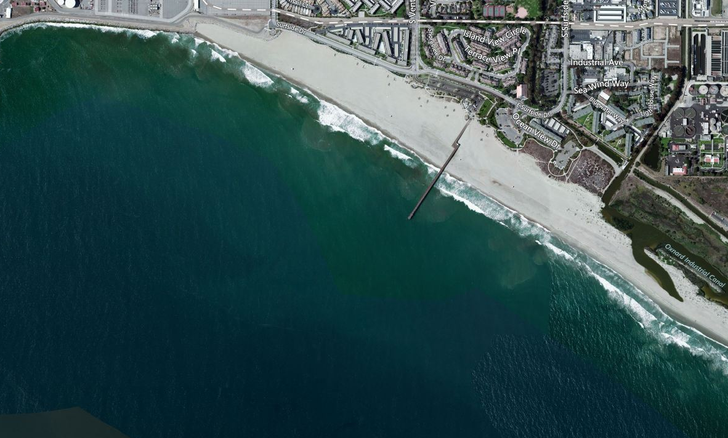
City of Port Hueneme
Hueneme Outfall
~5,000’ long
30” diameter

Slide 9
Hueneme Outfall
Pipe on the sea floor for an additional 2,300 feet from shore (past surf zone)
Beach
Pipe up to 50 feet below the sea bed for about 2,300 feet from shore
Diffuser on the sea floor for an additional 400 feet from shore

Slide 10
Horizontal directional drilling
Barge
Drill rig
Pipe
String of steel rods

Slide 11
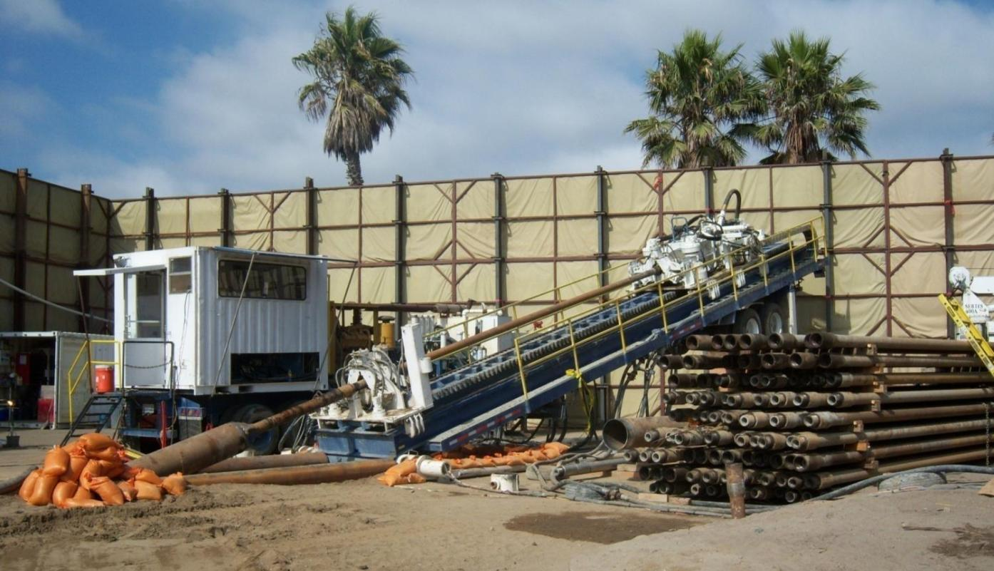
Drill rig for installation of the outfall

Slide 12
Tugboat and barge

Slide 13
Pipe Stringing Area at
Point Mugu Naval Air Weapons Center

Slide 14
Pulling pipe string across beach at Pt. Mugu

Slide 15
Floating pipe string over to Hueneme Beach

Slide 16
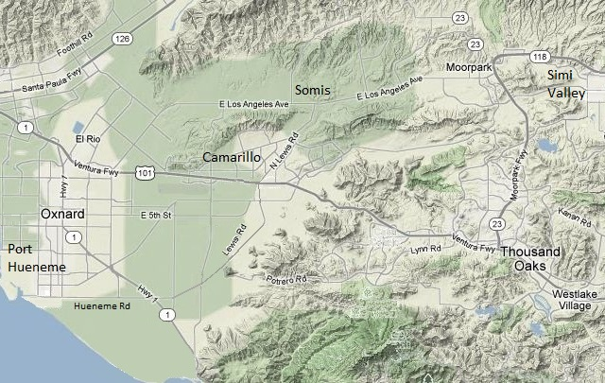
Moorpark
Desalter
Simi Valley
Desalter
Las Posas
Ag Desalter(s)
North Pleasant
Valley Desalter
Hill Canyon
Desalter
Santa Rosa
Ag Desalter(s)
Oxnard Plain
Ag Desalter(s)
Conejo Valley
Desalter(s)
Round Mountain
Desalter
Port Hueneme Desalter
Groundwater desalters are being planned and built

Slide 17
In closing… One water supplier’s perspective
Southland water agencies have clearly demonstrated their commitment to regional water solutions and sustainability.
Metropolitan’s leadership in conservation and the development of alternative water supplies is to be commended.
Chronic lack of Delta water reliability places the health of our economy at risk… and has for decades.
A Delta fix must include new conveyance facilities truly capable of meeting the needs of California’s water users.

