Slide 1
California’s Energy Outlook and Consumer Demand

Slide 2
According to the California Energy Commission, in 2018, California was the 3rd Largest Gasoline Consuming Market on the Planet. Behind the U.S.(1) and China (2)
3rd
Largest
Source: U.S. Census Bureau, 2018
30%
Population Increase Predicted.
from 39 million in 2015 to 50 million people in 2050
Pew Research Center

Slide 3
35 Million
655,088
Motor Vehicles
ZEVS sold
More than in any other state, and longest commute times in America
Source: CA DMV, 2019, CA New Car Dealers Association 2019

Slide 4
Consumed daily in California :
42 Million
2017
Gallons Gasoline
8.4 Million
Saw the Highest Level of Consumption
Gallons Diesel
Consumption has Historically Increased With Improved Economy.
0.5 Million
Gallons Jet Fuel
Source: California Dept of Tax and Fee Admin, 2018
Source: California Energy Commission (CEC)
Notes:
Compare these number to national refining numbers
California consumes 20% of jet fuel consumed in the US- IEA- 2018

Slide 5
100%
84 Million
Crude oil produced in California
is utilized by California refineries
Gallons of Oil a Day Processed by CA Refineries
Imports of foreign oil are expected to increase as CA production continues to decline.
Source: California Energy Commission, 2018

Slide 6
Meeting Consumer Demand
30%
70%
Crude oil produced in California
Imported to Meet California’s Energy Needs, Mostly from Foreign Countries that Don’t Apply California’s Safety, Labor, and Environmental Standards.
Source: California Energy Commission, 2019

Slide 7
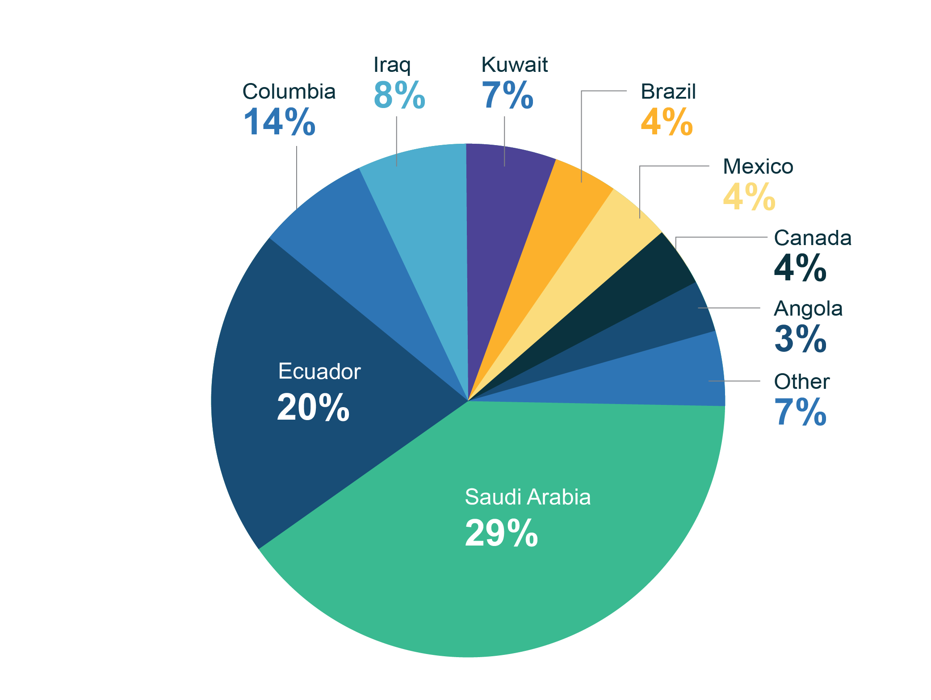
Sources of Crude Oil Imports to CA
Sources: “Foreign Sources of Crude Oil Imports to California 2018,” California Energy Commission Energy Information Administration. Please note that total of foreign oil receipts to refineries may not exactly match that shown on other pages.

Slide 8
Impacts of in-state production bans
$1.7 Billion lost in tax revenues to schools, public safety, local governments
55,000 production jobs lost: diverse, high wage jobs
Increased gas prices up to $2.33 per gallon
Source: Capitol Matrix- Impact of a Statewide Oil Production Ban on Downstream Petroleum Markets,2019

Slide 9
