Slide 1

Responses to the Drought
What Else Might Be Done?
Dr. Kartiki Naik and Madelyn Glickfeld
Director, UCLA Water Resources Group

Slide 2
Three Ideas
Money for effective mass and local communications: Make a deeper impact on consumer behavior through effective communications that go beyond understanding the seriousness of the drought..
Constitutional Amendment re 218: Respond to the San Juan Capistrano Case: by recognizing water scarcity and the critical role of price on the volume of use. Price is about more that cost, but value of a scarce resource.
Start now to make the water efficiency of water distribution and storage infrastructure an integral part of the water conservation program for all water agencies.
Notes:
Need to overcome finger pointing and create a sense that we are all in this together.
Need to give the consumer better info about their water use, and how much they need to reduce, and how to do it.
Need to strengthen the sometimes really inadequate capacity of many water retailers to communicate with their customers effectively and deliver conservation services.
.

Slide 3
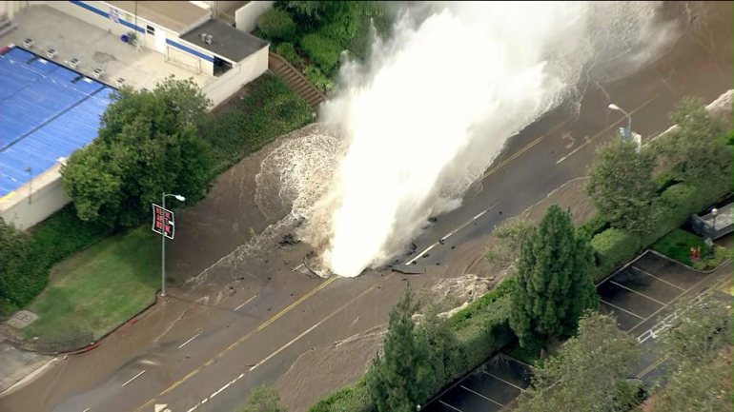
10 million gallons
2% of the daily use
for 3.4 million customers
Can they conserve, if they cannot maintain their distribution system?
Is the current reporting system adequate to assess their water distribution efficiency?
http://ktla.com/2014/07/29/water-main-break-in-westwood-prompts-flooding-of-streets-strands-people/

Slide 4
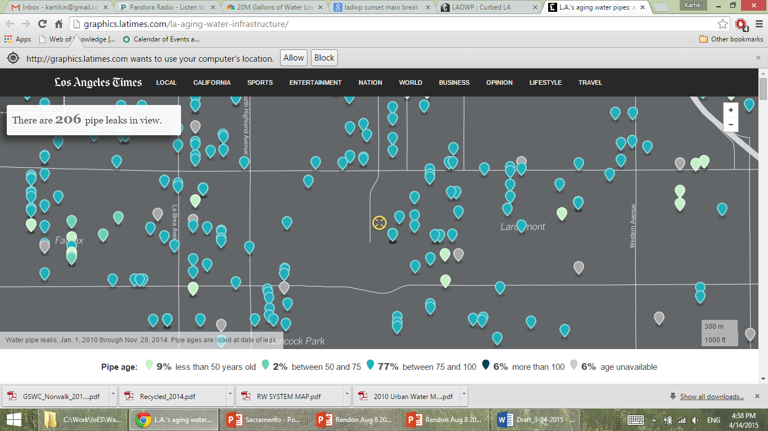
Data on Leakage in the City of Los Angeles
http://graphics.latimes.com/la-aging-water-infrastructure/
Notes:
Just a neighborhood in Hollywood– four years of leaks/breaks. This is not particular to Los Angeles, but it was one of the two places we know map these.

Slide 5
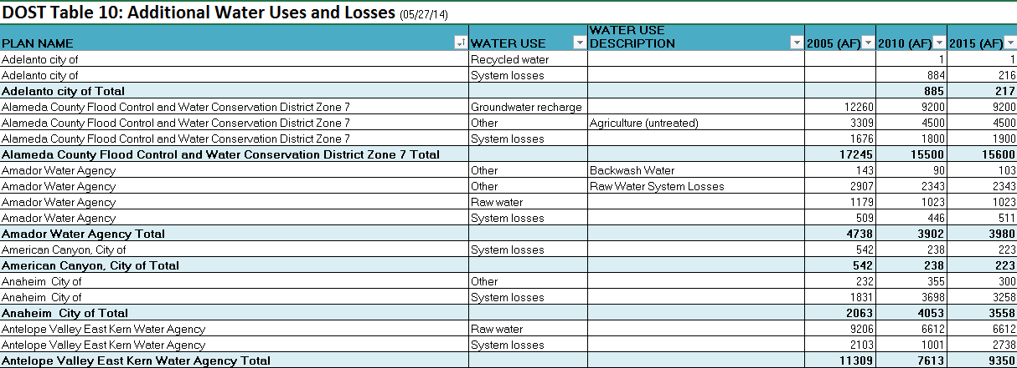
Current Retailer Reporting to the State is inadequate to assess water system efficiency

Slide 6
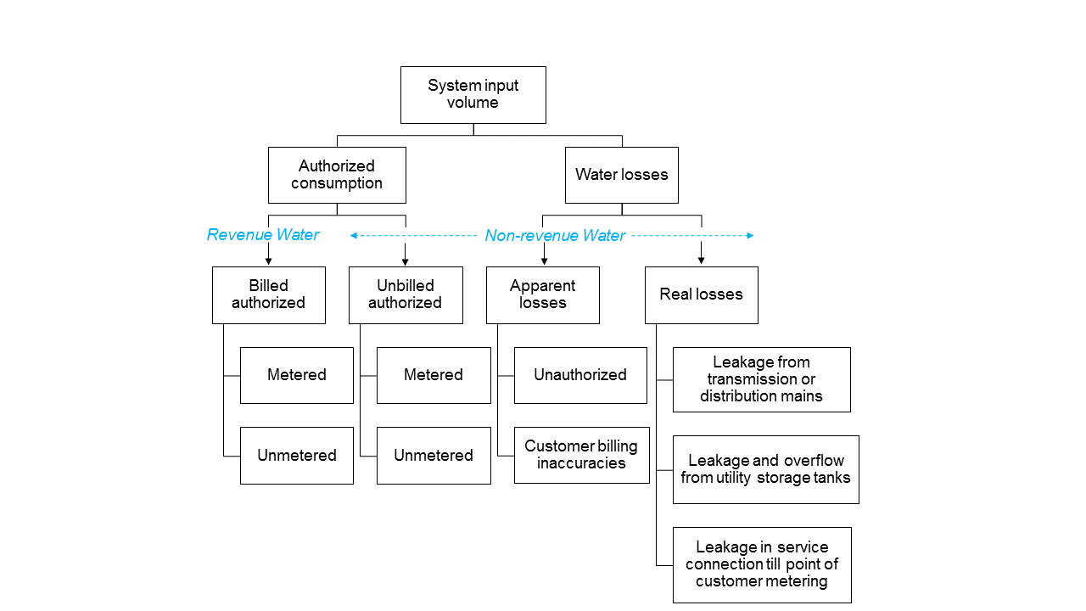
Water Auditing Approach

Slide 7
Water Distribution Efficiency - Status Quo
Many retailers do not monitor real losses
Most retailers who do monitor, use percent of total water lost , which can distort results
No funds other than water rates revenue to maintain and replace pipe.
Currently, no reliable reporting to State to determine water distribution system efficiency of retailers
Notes:
Have 35% cite for manual, % distorts, efficiency not a big topic among water retailers

Slide 8
Los Angeles County Water Efficiency Survey
Does the complex array of water retailer sizes and types in Los Angeles County impede water efficiency management ?
Might this indicate a lack of capacity to transition from imported to local water sources?
With consumers conserving, water retailers must improve efficiency
  Legislature and State Water Board focused on improving water efficiency reporting
Notes:
Sampled across urban LA by type, sub-region and size of water retailer
Contacted 19 water retailers to get 10 interviews

Slide 9
Study Area in Urban Los Angeles County
A glimpse of the current status of water retailers in urban Los Angeles County
A context for upcoming policy decisions to reduce water losses through infrastructure, thus supporting conservation efforts
Cheng and Pincetl, in press 2015, map not peer -reviewed . Funded by National Science Foundation award number 1204235,
Notes:
Over three thousand water retailers statewide.
LA County 228 systems ranging from many that serve one use to the LADWP that serves several million. Irrigation districts, mutual water companies, independently owned water utilities under the PUC, several kinds of county water districts, special districts created by the Legislature and over 40 cities with water departments or utilities

Slide 10
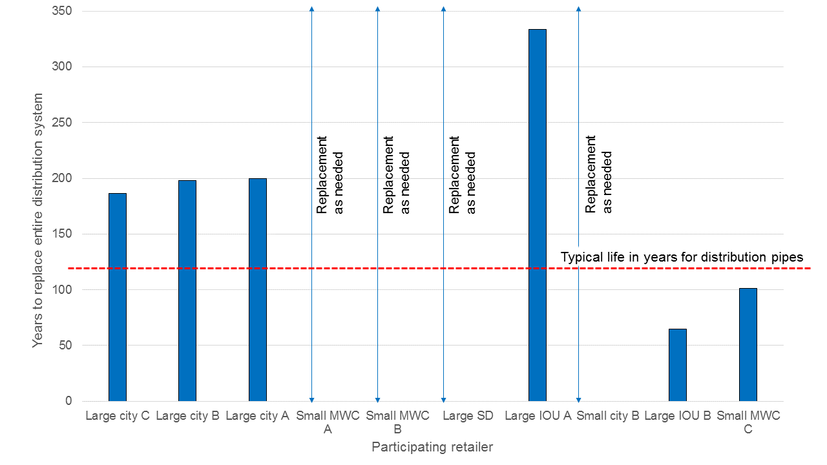
Pipe Replacement
Sample size = 10
The UCLA main break happened here!
Most breaks in the city of LA occur here
http://graphics.latimes.com/la-aging-water-infrastructure/
Notes:
Few WD are replacing before 100 yrs
many not keeping up
Many responding to breaks

Slide 11
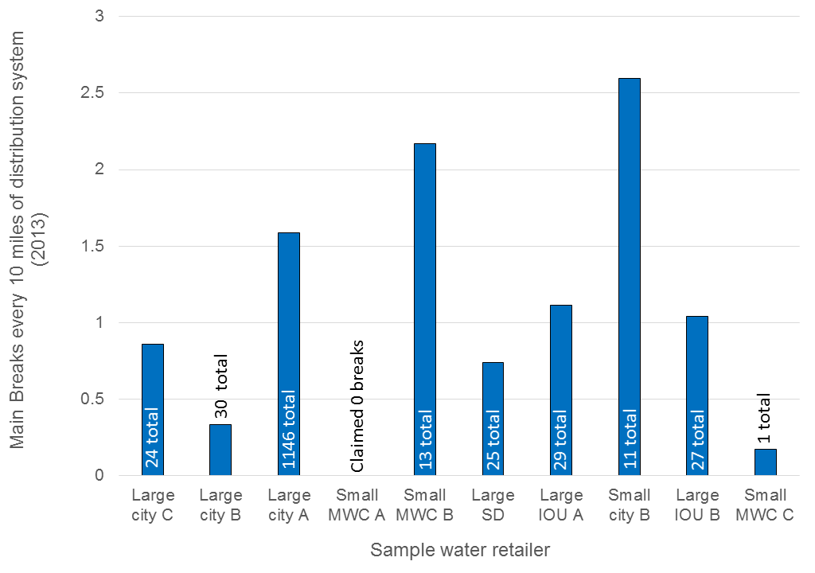
Breaks and Losses - 2013
Sample size = 10

Slide 12
Real Water Loss
Sample Retailer | Real Losses (%) | Unaccounted for water (%) | Verification
Large City C | Not measured | 2.8 % | No
Large City B | 3.4 % | 4.5 % | Yes
Large City A | 4.1 % | Measures real loss | Yes
Small MWC A | Not measured | 3 % | No
Small MWC B | Not measured | 11.35 % | No
Large SD | 4 % | Measures real loss | Yes
Large IOU A | No response | 1 % | No
Small City B | No response | 6.5 % | No
Large IOU B | 4.02 % | Measures real loss | Yes
Small MWC C | No Response | No Response | No
Responders | 7 out of 10 | 9 out of 10 | 4 out of 10
Notes:
Large City A, if it were Los Angeles, would be losing 20,500,000 gallons per day, every day with a 4.1% loss. While Small MWC with 3000 connections and the same 4.1% real loss rate would be losing around 18,100 gallons per day. But only 4 of the 10 could provide us with any documentation of their real losses.

Slide 13
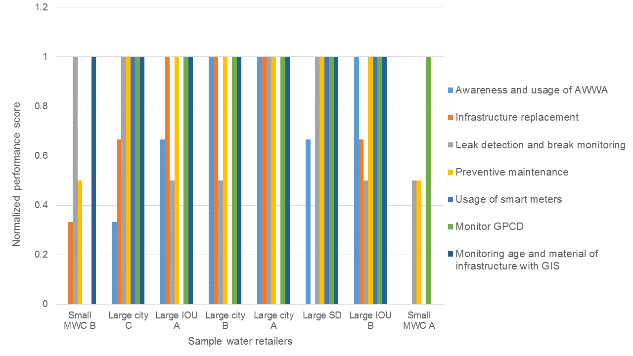
Overall Performance
Results | Size | Type
Overall performance | Large retailers (high, p=0.0034) | MWCs (low, p=0.0035)
Notes:
Rated on seven different attributes that would make the water distribution system efficient. Findings: Large water retailers can do this better than small, and Mutual water companies, are on average the weakest.

Slide 14
Conclusions: SB 555 (Wolk and Pavley) + is needed!
Requires complete annual water loss audit based on AWWA methodology
Develop valid metrics for reporting based on new data coming in: Uses volumes of water rather than percent. Meter everything possible
State needs to make sure that retailers get information on water technology and technical assistance for water loss detection programs
  Varied opinion of leak detection technology
Find a way for small water retailer to pool resources to improve water efficiency audits
Advocate for a Federal Local Public Water System Infrastructure Financing Bill to renew infrastructure.
Notes:
CWF: la – 1. local water, fragmented, small is bad
2. Influencing legislation
3. More work to do: work on the retailers side: especially small ones

