Slide 1
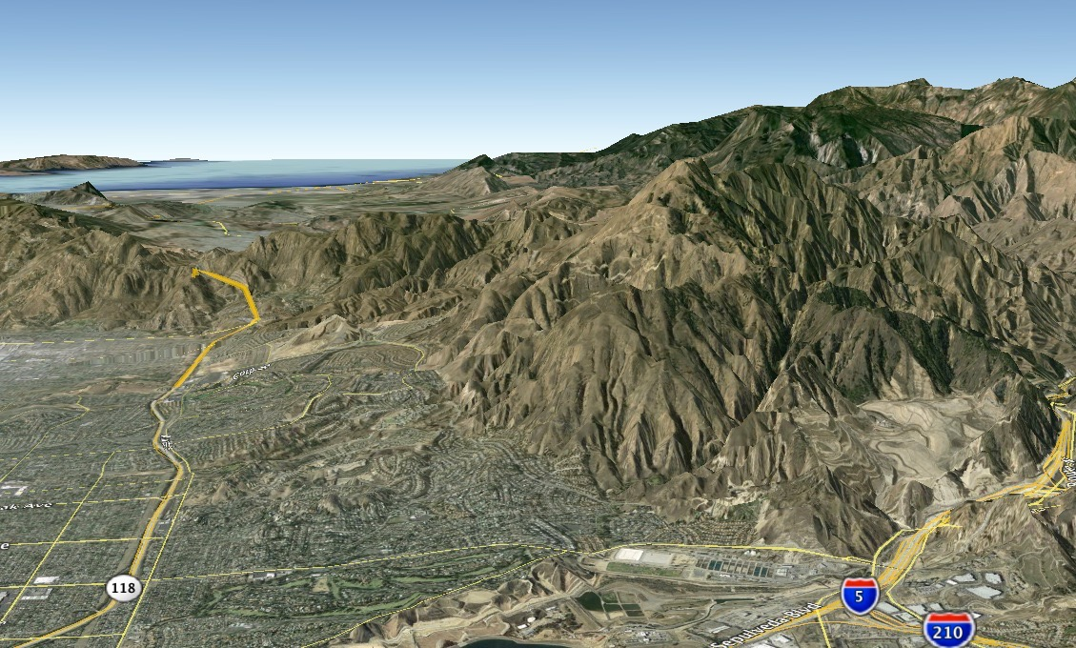
Seismic Hazard at Aliso Canyon
Aliso
Canyon
Porter Ranch
Santa
Susana
Fault
Granada Hills
Dr. Matthew d’Alessio
Department of Geological Sciences
California State University Northridge

Slide 2
Aliso
Canyon
Porter Ranch
Santa
Susana
oil
Fault
oil
Geology layers based on the map by Diblee

Slide 3
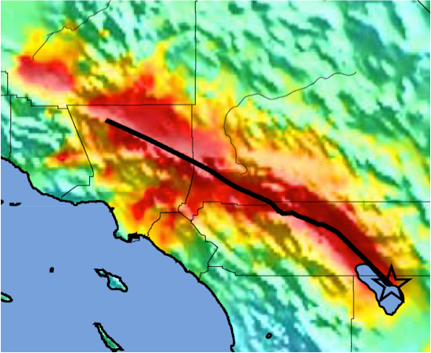
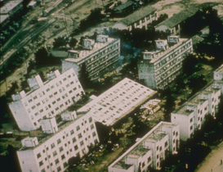
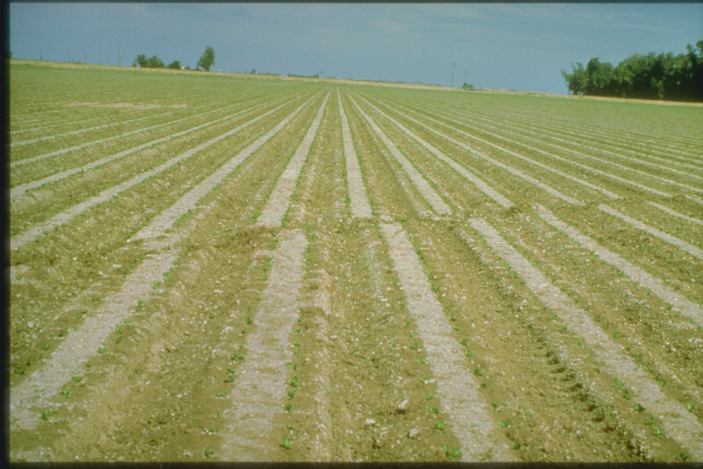
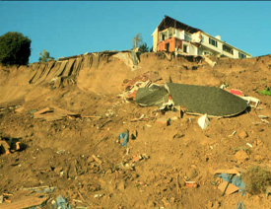
California law requires that CGS map zones at risk
for both direct and indirect impacts of earthquakes.
Direct Impacts
Indirect Impacts
Ground shaking
Liquefaction
Fault
Rupture
Landslides

Slide 4
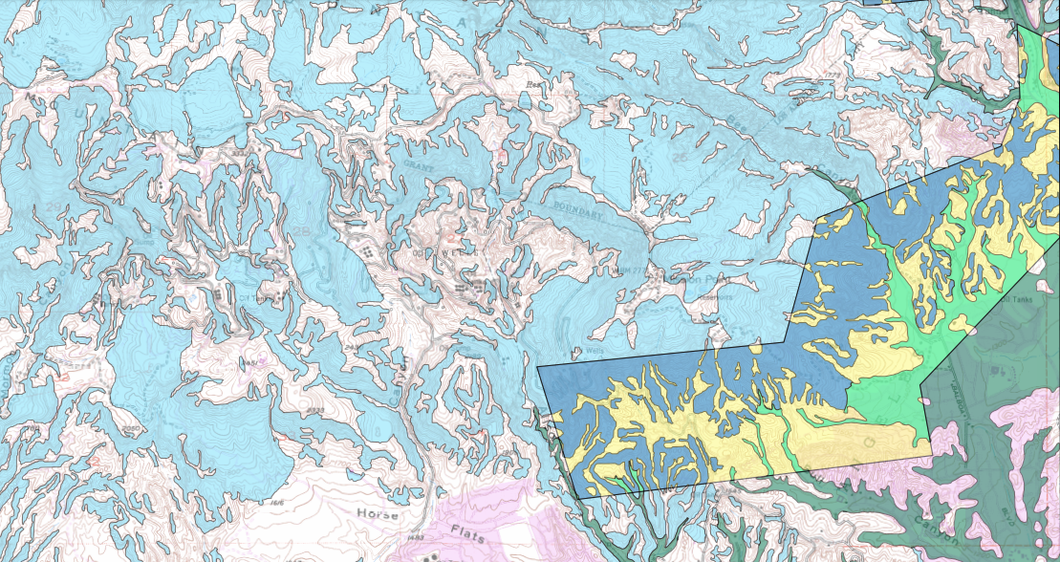
The Santa Susana Mountains are hazard-prone.
Liquefaction hazard
Landslide hazard
Fault rupture hazard
Aliso Canyon Storage Facility
Well collapsed in 1994 earthquake
Fernando Fee 32 A-H
(8 active, 1 inactive)
Fernando Fee 38B x 2
Fernando Fee 35A, B
Fernando Fee 35C, D, E
Fernando Fee 33
Fernando Fee 34BR
Mission Adrian 1A
Fernando Fee 34A
Mission Adrian 1B
Mission Adrian 3
unmapped for fault rupture hazard
LA County
LA City
1971 Surface Rupture
Notes:
Map shows 62 active wells (as of date I checked a few weeks ago) and omits others that are temporarily isolated but have not passed inspections yet.
Well collapse documented in SoCalGas Risk Management Plan #2, ftp://ftp.consrv.ca.gov/pub/oil/SCG_Attachment/B/4_supplement_socalgas_storage_risk_management_plan2_10-11-2016.pdf (p. 6)
Well SS-4O, https://secure.conservation.ca.gov/WellSearch/Details?api=03722063

Slide 5
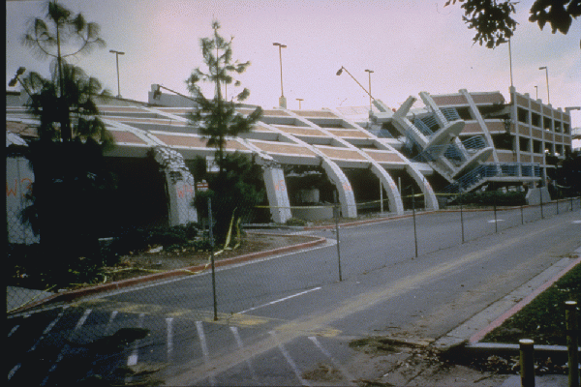
8 x 1994 Northridge earthquake.
1994
Northridge EQ
1994
Northridge EQ
A M7.3 on the Santa Susana fault
up to M7.3
1994
Northridge EQ
1994
Northridge EQ
=
1994
Northridge EQ
1994
Northridge EQ
1994
Northridge EQ
1994
Northridge EQ

Slide 6
SoCalGas commissioned a multi-part seismic hazard study to quantify risks.
Faults
Earthquakes
Well damage
Blowouts
Gas Flow

Slide 7
The study identifies some serious concerns, which is not unexpected given the location.
Faults | Active faults cut across the wells
Earthquakes | Expect big earthquakes
Well damage | Wells leak when they rip apart
Blowouts | Some gas will remain trapped underground
Gas flow | Worst case: 62 wells leaking simultaneously

Slide 8
The study anticipates damaged wells from several effects.
Direct Impacts
Indirect Impacts
Ground shaking
Liquefaction
7 wells might leak in a really strong, distant earthquake.
Not relevant
Fault
“Only a few” wells
Rupture
Landslides

Slide 9
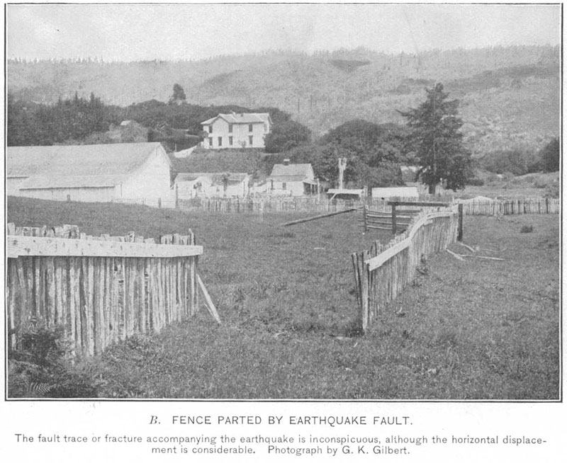
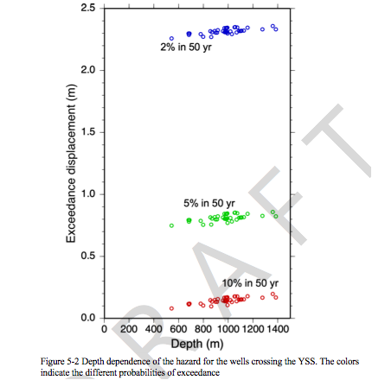
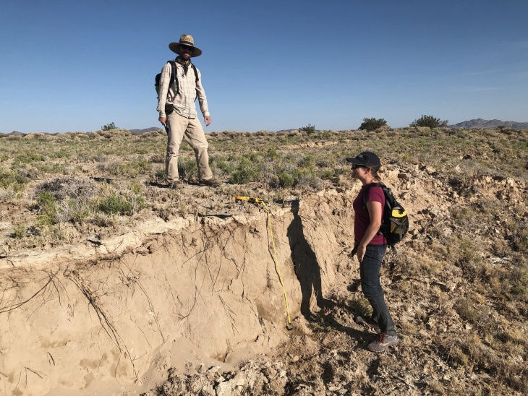
What’s the probability of different size earthquakes in the next 50 years?
2% chance of 8 feet+
5% chance of 2.5 feet+
2.5 feet
10% chance of 6 inches+
Report 6, p. 27
with well failure conclusions from Report 7, p.

Slide 10
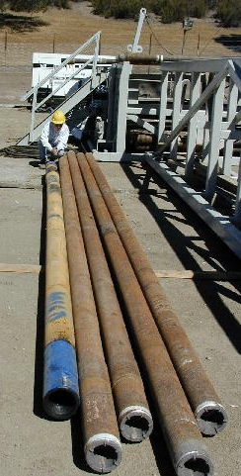
Regulations enacted after the blowout require two layers of containment.
“A straw within a straw”
Steel casing
Steel tubing
https://www.icdp-online.org/projects/world/north-and-central-america/san-andreas-fault-usa/gallery-pilot-hole/

Slide 11
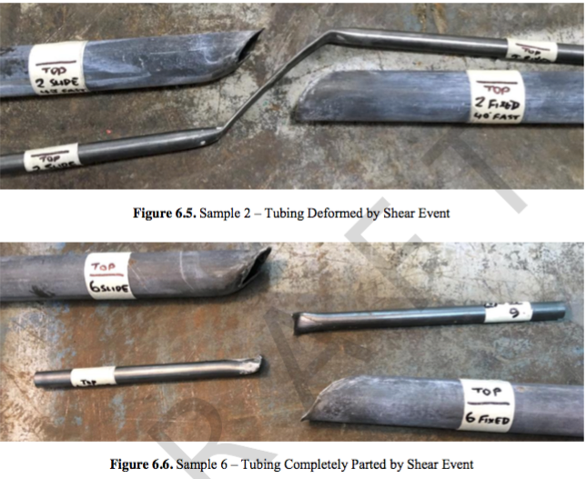
When subjected to this much offset,
steel casing AND tubing can fail.
Outer casing broke in all cases.
Tubing leaked in 16 of the 18 cases.
Report 8, p. 34

Slide 12
This independent seismic hazard study is based on laboratory and computer simulations
“The tectonically induced casing/tubing damage described above normally does not result in loss of hydrocarbon containment outside of the wellbore. “
included no supporting evidence
– SoCalGas Risk Management Plan #2, 2017
Tubing leaked in 16 of the 18 cases
Report 8, p. 34

Slide 13
What’s the probability of different size earthquakes in the next 50 years?
2% chance of 8 feet+
All 62 wells fail
5% chance of 2.5 feet+
48 of 62 wells fail
2.5 feet
10% chance of 6 inches+
Report 6, p. 27
~40 of 62 wells fail
with well failure conclusions from Report 7, p. 181

Slide 14
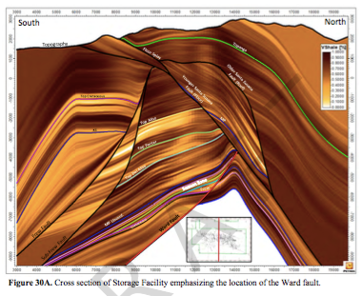
If a single well is ripped apart in an earthquake, how much gas will make it all the way up to the surface?
These rocks have successfully trapped the gas for millions of years.
4500 ft = 15 Statue of Liberties
https://www.youtube.com/watch?v=fFUxq9UolN4

Slide 15
Gas can leak up the outside of the ruptured well or along the fault

Slide 16
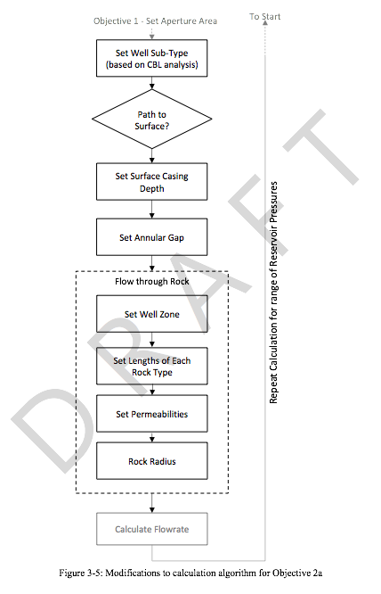
They ran hundreds of thousands of simulations with different assumptions.
"Many cases show no gas flow to surface because the tubing does not leak or the cement bond between the casing and rock formations is adequate to halt upward gas migration.”
The great thing about science is that we quantify our uncertainty.
Report 9, p. 30

Slide 17
If a single well fails…
The ‘middle of the road’ case (50% worse, 50% better) | 0.01 to 0.1 MMscf/day
10% of the cases are worse than this | 10 MMscf/day
2015 SS-25 Blowout | 80 MMscf/day
Shaw Summary, p. 8
Aliso Canyon Peak, ARB

Slide 18
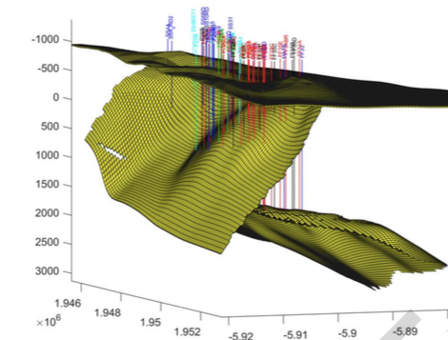
But a major earthquake will simultaneously rupture all 62 wells.
The ‘middle of the road’ case (50% worse, 50% better) | 0.25 MMscf/day | 1 MMscf total over 5 years
10% of the cases are worse than this | 250 MMscf/day | 40 Bcf total over 5 years
2015 SS-25 Blowout | 80 MMscf/day | 5.4 Bcf
Tiny
Tiny
3x Aliso
8x Aliso
Shaw Summary, p. 8
Aliso Canyon Peak, ARB
Report 10, p. 23

Slide 19
PROBLEM: The Draft report uses pre-earthquake measurements of rock permeability, but earthquakes loosen old fractures and create new ones.
Pre-Earthquake
Post-Earthquake
≠
Permeability typically 10-100 times higher than pre-earthquake
https://www.icdp-online.org/projects/world/north-and-central-america/san-andreas-fault-usa/gallery-pilot-hole/

Slide 20
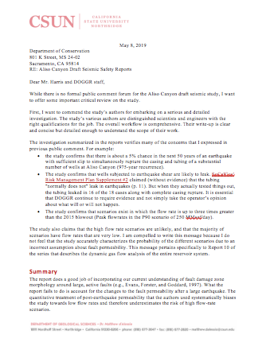
I have shared these concerns with DOGGR in a letter dated May 5, 2019.
I received a reply from their Legislative Affairs office on June 5 confirming receipt and indicating “your comments will be reviewed and considered.”

Slide 21
Worst case scenario is 8x the emissions of the 2015 blowout.
They need to revise their model to provide you an accurate probability.
Using their current model,
5% chance of a sufficiently large earthquake in the next 50 years
At least 10% chance if that earthquake happens.

