Slide 1
Southern California Regional Watershed Supply Alternatives
“The Role of Stormwater”
Richard Atwater, Executive Director Southern California Water Committee
Senate Natural Resources Comm.
March 12, 2013

Slide 2
So Cal & Stormwater
Approximately ½ of Southern CA’s water comes from imported sources:
Colorado River
Sacramento-San Joaquin River Delta
Climate change, aging infrastructure and impacted habitats are further reducing the reliability of the major delivery systems of imported water
CA needs to invest in statewide action to improve reliability of imported water & we need to develop more local water supply
More than 3 million people added to the population while imported water use has remained essentially the same

Slide 3
Role of Stormwater
Stormwater capture, with imported water and recycled water, is the foundation to local groundwater supplies.
Clean Water Act “MS4 permits focus on urban runoff pollution”
Water Bond Funding --Multibenefits
in IRWMs can do both!

Slide 4
2010 Service Area Water Supplies
Total Retail Demand: 3.6 MAF

Slide 5
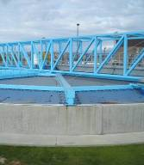
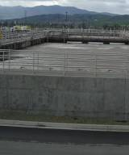
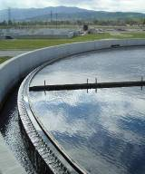
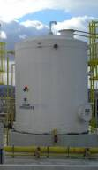
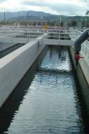
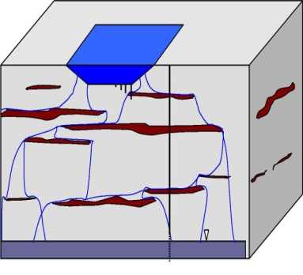
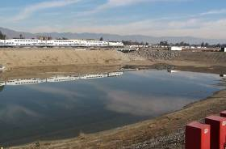
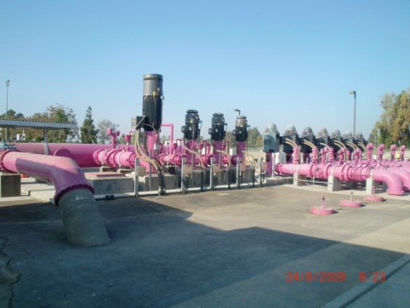
San Gabriel River Recycled Water Production Cycle
Primary
Secondary
Tertiary
Industrial Pretreatment & Source Control
Influent TOC
Avg. 165 mg/L
Distribution System
Industrial & Brine Export
Groundwater Blend & Hold
Soil-Aquifer Treatment
50% TOC Removal
to ±1 mg/L
75% TOC Removal to ±2 mg/L

Slide 6
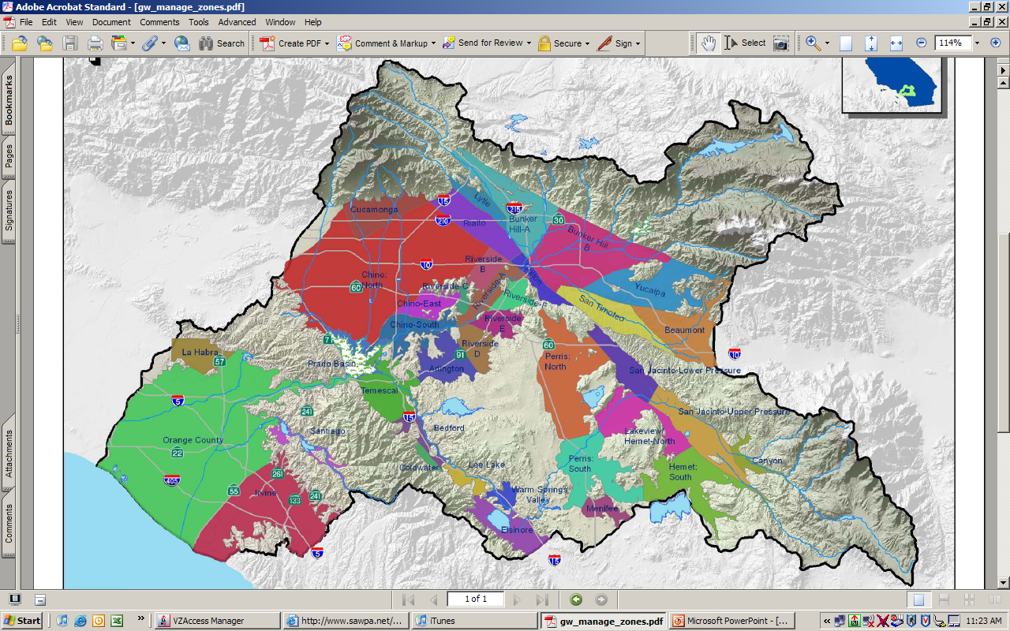
Santa Ana River Watershed

Slide 7
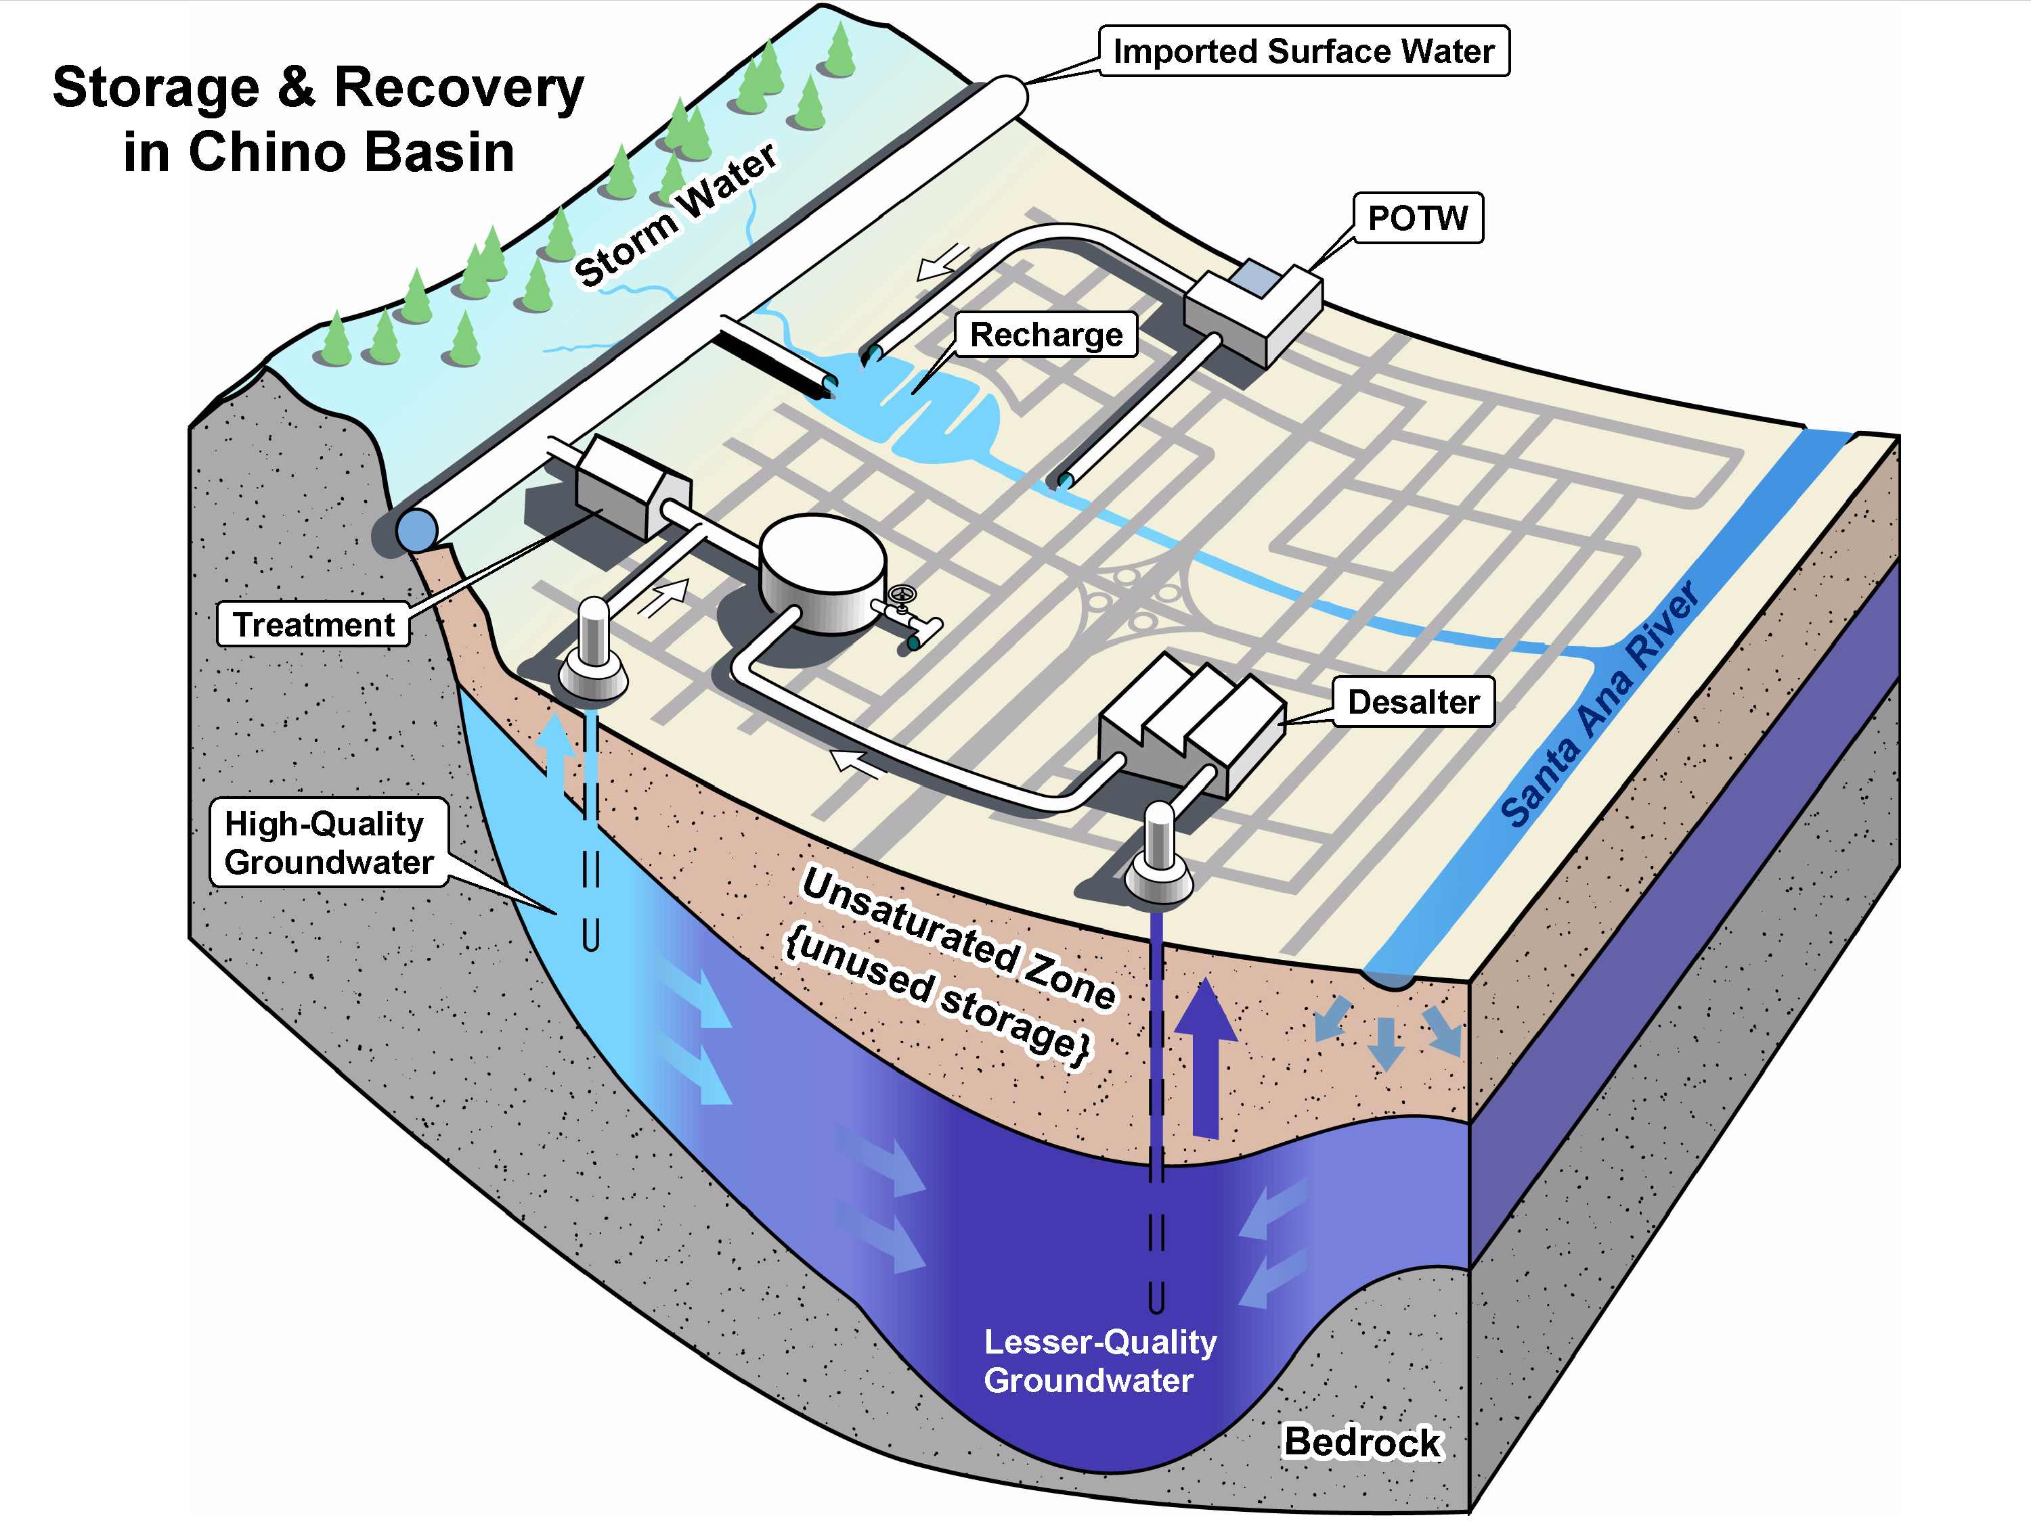

Slide 8
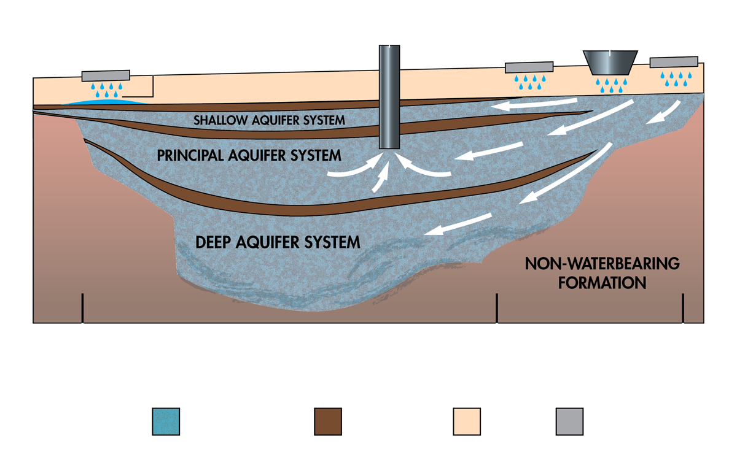
Deep Percolation of Stormwater
Not to scale
Water bearing sand and gravel
Impervious clay and salts
Surface soil
Onsite infiltration practices

Slide 9
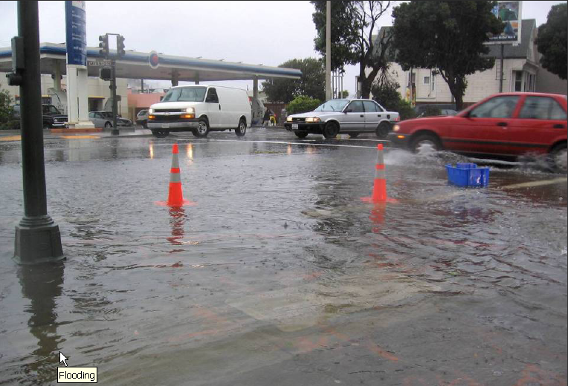
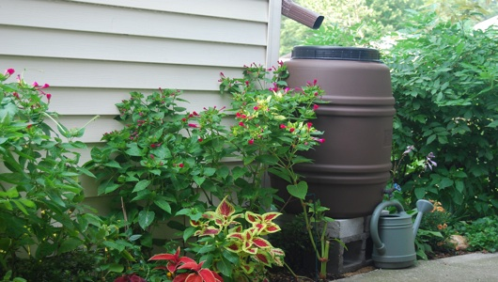
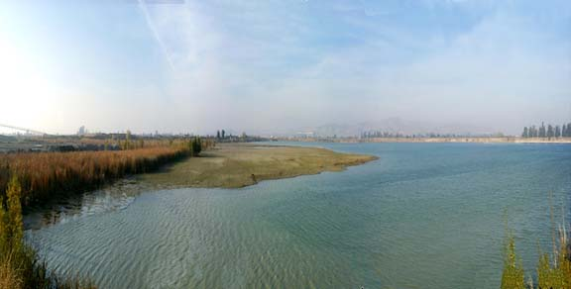
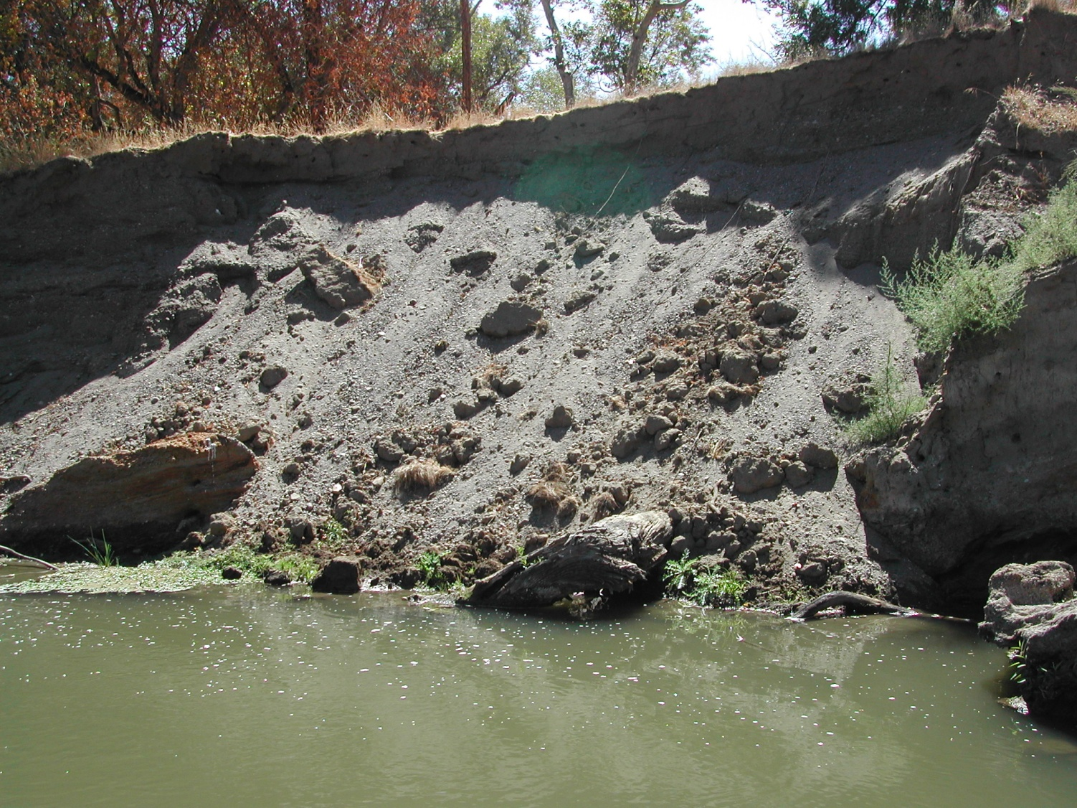
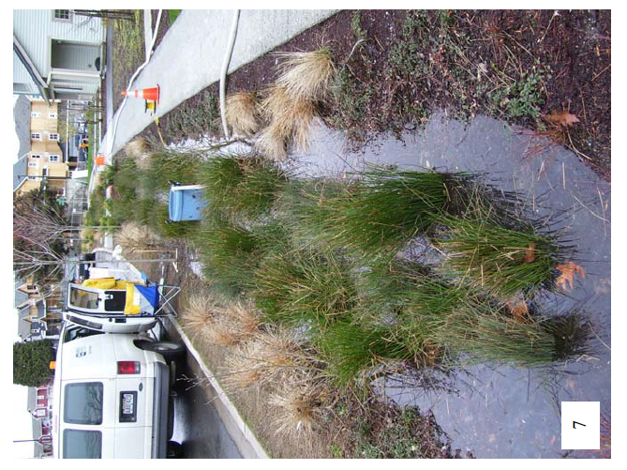
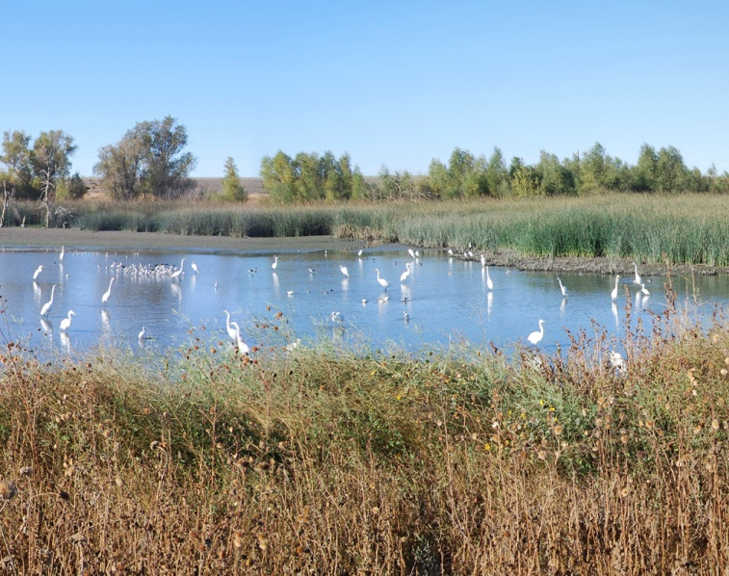
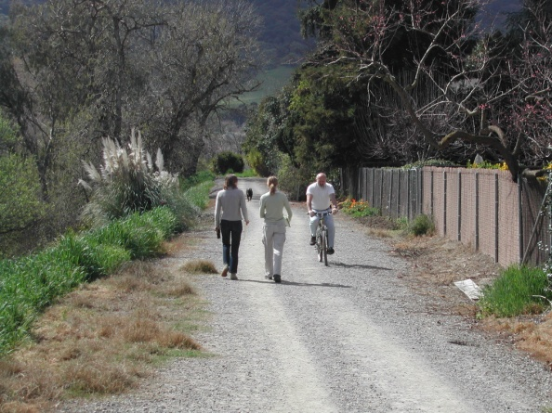
Multi-Use Project Types
Flood Protection and Drainage
Site Specific LID -- Water Supply and Water Quality
Traditional Water Supply
Erosion and Sedimentation
Water Quality Streetscape
Habitat and Environment
Recreation Trails and Education

Slide 10
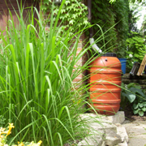
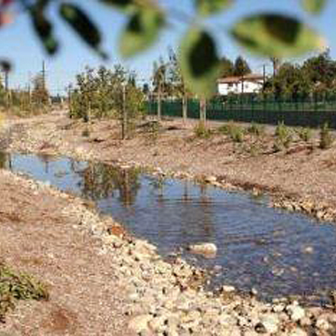
Stormwater Capture Types
Individual
Neighborhood
Large Scale

Slide 11
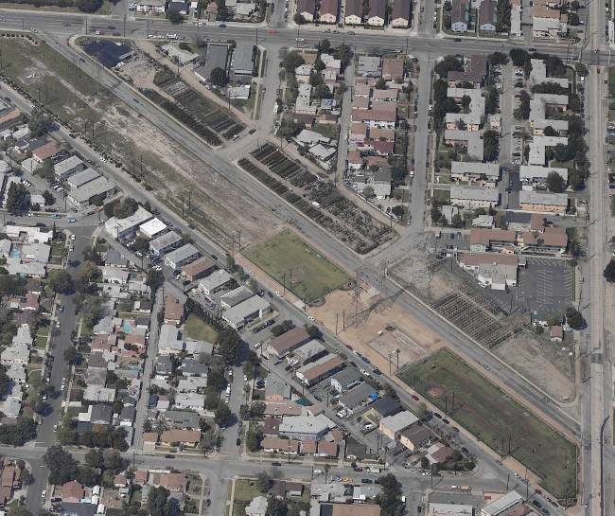
Small Scale Projects
Whitnall Highway Power Line Easement Project
LADWP Project.
Conceptual plan being developed.
Project expected to increase groundwater recharge by more than 110 acre-feet per year.
Goal is to capture and infiltrate stormwater beneath LADWP power lines using swales and ponds.
Designs expected in 2013.

Slide 12
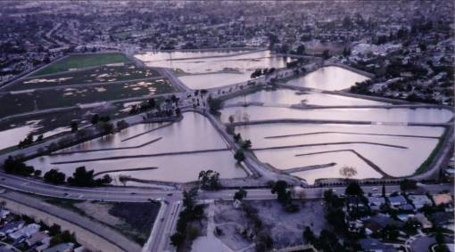
Large Scale Projects
Pacoima Spreading Grounds Project
LACFCD/LADWP Project.
Estimated cost $32 million.
Increased recharge by 2,000 acre-feet annually.
Designs expected in late 2012.
Lopez Spreading Grounds Project
LACFCD/LADWP Project.
Increased recharge by 750 acre-feet annually.
Designs expected in 2013.
Estimated cost $8 million.
Courtesy of Los Angeles Department of Water and Power

Slide 13
Stormwater: A Smart & Sensible Solution
450,000 acre-feet of stormwater is currently captured and recharged into So Cal groundwater basins per year (enough water for 3 million people/year)
Billions of gallons are lost every year because we don’t have enough stormwater capture systems
Capturing stormwater is viable, cost-effective and environmentally preferable
Capturing stormwater provides numerous benefits, including:
Creating more local water supplies
Reducing polluted run-off
Providing a cost-effective water supply option

Slide 14
Water Bond Funding
Stormwater funding for both clean water and supply integration is done best through multiple benefit integrated watershed planning, like the success of the Santa Ana River
Bond funding should encourage this type of grants to watershed multi benefit projects.

Slide 15
Thank You!
Richard Atwater
Southern California Water Committee
For more information, please visit www.socalwater.org.

